Slide 1

Columbia Housing Authority
Housing Choice Voucher Program
New Resident Briefing
Please Sign In and Sign and Date Handbook Table of Contents Sheet
Notes:
Ask everyone to sign resident handbook sheet and pass up or collect

Slide 2
Participant Handbook
All you need to know about the HCV Program
Notes:
Start on pg 7

Slide 3
Terms of the Voucher
120 Calendar Days
Extension:
  30 Days
  Must be Submitted in Writing to Director with Supporting Documentation (Progress Report)
  Two Weeks Prior to Expiration
Suspension:
  Once CHA has Landlord Packet
Expiration
  Cannot file Extension After
  Can Reapply when Waitlist is Open

Slide 4
Rent Calculation
Annual Income – Allowance = Adjusted Annual Income
TTP (Total Tenant Payment) is the highest of the following:
  30% of Adjusted Monthly Income
  10% of Monthly Income
  Or Minimum Rent (CHA minimum rent is $50.00)
Max Rent Burden: 40% of adjusted monthly income toward the initial rent and utilities for the unit. This limit applies only at time of leasing of a unit and not after being continuously assisted in the same unit.

Slide 5
Rent Calculation (cont.)
Payment Standards: Rent + Utilities
  1 bdrm: $948
  2 bdrm: $1,107
  3 bdrm: $1,496
  4 bdrm: $1,761
  5 bdrm: $2,026
Rent Reasonableness:
  If Rent Exceeds Standards, Tenant Pays Difference
  Can Not Exceed Max Rent Burden (40% Income)
  Must be within reason (+1 bedroom, Better Location and Age, Unit Type, Security, etc.)

Slide 6

What is Portability?
Portability is a term used to describe a family’s ability to move from one Public Housing Agency’s (PHA) jurisdiction to another location outside the jurisdiction of the original PHA and continue to receive assistance
If the head or spouse of the assisted family did not have a legal residence at the time of its application, the family will not have any right to lease a unit outside of CHA jurisdiction for a 12-month period beginning when the family is first admitted to the program. During this period, the family may only lease a unit located in the jurisdiction of CHA.
Portable families will be required to comply with the receiving housing agency’s procedures for portable families and they will determine the family unit size based on their subsidy standards.
Notes:
A person may transfer or “port” their voucher anywhere in the United States as long as there is HA managing an S8 program.

Slide 7
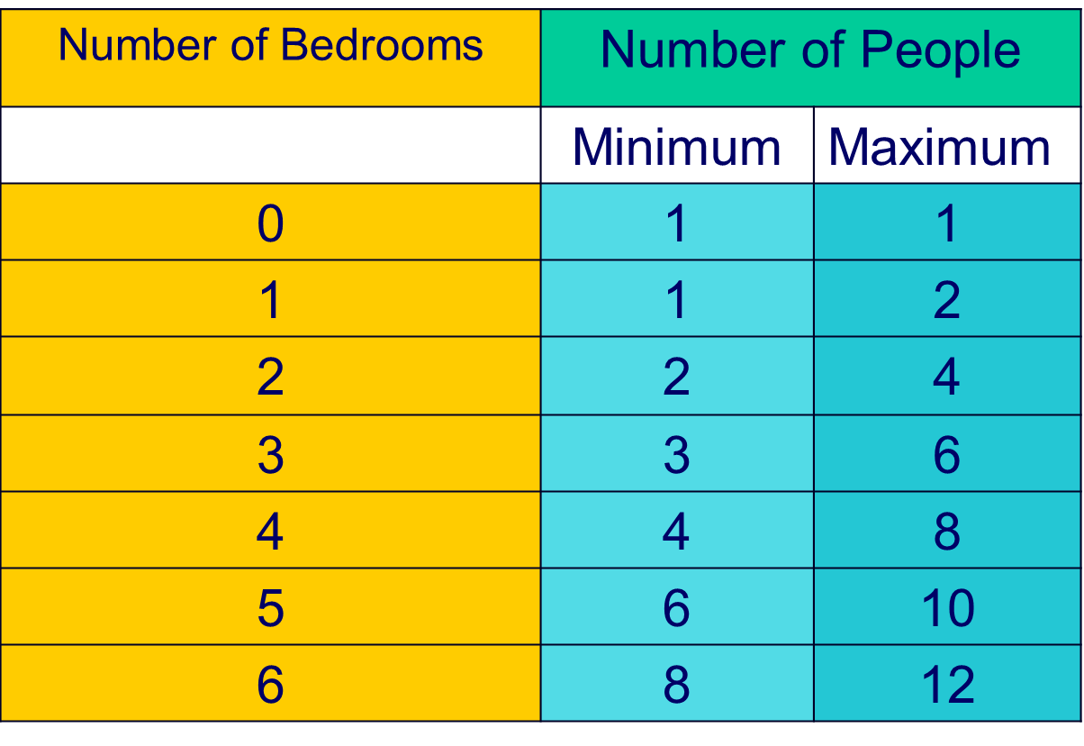
Subsidy Standards
(Voucher Bedroom Size)
2 Persons per room, except:
Persons of the opposite gender (other than spouses or children under 2)
Children of same gender with an age difference of 18 years
Live-in Aides will be allocated a separate bedroom
Single Persons will be allocated 1 bedroom
*Exceptions: Reasonable Accommodations
Notes:
Pg 10. Point out the “voucher size” on their voucher is their bedroom size. If two siblings of same sex, needs 18yr age gap to have their own bedroom.

Slide 8
Family Obligations to the Housing Authority
The family must follow the rules listed below in order to continue participating in the Housing Choice Voucher Program
Supply Complete & Truthful Information requested by CHA (Citizenship, Income, Composition, Social Security Numbers, etc.)
Maintain HQS & Correct any Tenant Responsible Defects
Allow CHA to Inspect Unit
Do NOT Commit Lease Violations (Nonpayment of Rent, Disturbance, Destruction, Damage. Criminal Activity, etc.)
Notify CHA of Move-out, Termination of Lease, or Eviction (in writing!)
Notify CHA of changes in Family Composition (Compete an Add to Lease prior to Move In or Notify CHA of a Move Out)
Must Live in the Unit, Not Sublease Unit, nor Currently Own the Unit (either in your name or family member name)
Notify CHA of Extended Absence (14 days)
Keep Utilities Current
Do NOT Commit Fraud nor Engage in Criminal Activity
No other Rental Subsidy other than HCV

Slide 9
Grounds for Termination
Eviction for Serious Lease Violations
Drug Related and Violent Criminal Activity
Violation of Any Family Obligation
Commit Fraud, Bribery or any Act of Corruption
Owing Rent or Debts to CHA
Violating Repayment Agreements and Non-Reimbursement
Physical/verbal Abuse toward CHA Personnel
Absent from Unit for 30 Consecutive Days
Unauthorized Guest
Shut-off of Utilities
Failure to Attend Appointments
Failure to Supply Requested Documents
Failure to Report Change in Composition or Income
Insufficient Funding*
Notes:
Pg 14. mention biggest reasons for terminations: UT shutoff, mailing address, unauthorized guests, violating crime free, reporting income changes , not attending appointments, unreported marriage

Slide 10
Informal/ Formal Hearings
Reasons to File:
  Determination for Annual/Adjusted Income
  Determination of Utility Allowance
  Determination of Unit Size or Over-Housing
  Termination of Program Assistance
  Termination of Family Self Sufficiency Contract
Scheduling:
  10 Days from Decision of CHA (letter)
  In Writing at Admin
  CHA will Schedule Hearing with Director
Formal Hearing:
  Same Process
  Hearing w/ Board

Slide 11
Change of Income or Family Members
Participant must report:
  Increase or Decrease in Household Income or Source
  Change in Family/Household Members
Submit within 10 Day
…IN WRITING!

Slide 12
Easy Leasing Steps
Find Suitable Unit (within 60 days)
  Schedule a Showing/Inspect/ Drive by Day, Night and Weekend
  Look up Neighborhood on Columbia Police Dept Website for Activity
Request Owner/Manager to fill out Landlord Packet
Landlord returns the Completed Packet
HCV Specialist Reviews & Approves Proposed Rent
Unit Passes Inspection
Verification of Utilities given within 10 days
Housing Assistance Contract & Lease is signed & returned to CHA
You May Now Move In!
Notes:
Overview of steps
Point out landlord packet- only 1 issued at a time and if replacement needed, they will need to ask their casemanager . Explain affordable & reasonable

Slide 13
Crime Free Addendum
All violent criminal activity
All drug related criminal activity
All sexual offenses
All crimes of robbery/arson/ burglary
All crimes of felony stealing
All crimes of armed criminal action
All crimes against the public order
All crimes of prostitution
All crimes of domestic assault
All street gang activity
Chronic & Persistent DWI
Animal abuse
Violation of the lease addendum for crime free housing will result in
Termination

Slide 14
Tenancy Addendum
Rules and Regulations for the CHA, Tenant and Landlord
Goes Over:
  Terms of the Program, Lease, Use of Contract
  Family Payment to Owner
  Other Fees/ Charges
  Maintenance, Utilities and Other Services
  Termination (Requirements and Grounds)
  Protection for Abuse Victims
  Security Deposit
  Prohibition of Discrimination
  Changes in Lease or Rent
  Definitions
Examples of Content:
  12 month lease term
  CHA must be given 60 day notice of Rent Increase
  Tenant will receive 30 day Notice of Payment Increase
  No “Extra” Deals made with Landlord
  Unit to be Maintained to HQS Expectations
  Landlord Eviction
  CHA must have 30 days intent to vacate unit
Notes:
Mention it is like the participant handbook. First years lease must be at least 12months.
deposit cannot be more the 1mo rent.
No “extra” deals to be made with LL
if the client is to pay more for their share of the rent they will receive 30 days notice (usually only changes if income is gained [if 0 income currently] or lost) otherwise it will change at next recert.
The tenant will not be held responsible for criminal activity in the unit if they are a certified victim of abuse (such as stalking/ physical abuse)
Remind them of keeping appliances clean and maintaining the unit. ***NEW SLIDE

Slide 15
Housing Quality Standards Inspections
Unit Scheduled for Inspection
Unit Passes
Landlord & Tenant Sign Lease
Landlord, Tenant and CHA sign HAP Contract
Unit Fails
Landlord Advised of Required Repairs
Landlord completes repairs (Go to Unit Passes)
OR
Landlord Doesn’t Complete Repairs (Applicant Continues House Searching)
Notes:
After this slide move onto “are you a victim of housing discrimination?” (mention they should read over it if the suspect they are to know the steps to take to file a claim). ***MOVE TO LEFT SIDE*** point out brochures they may read at their convenience for helpful information

Slide 16
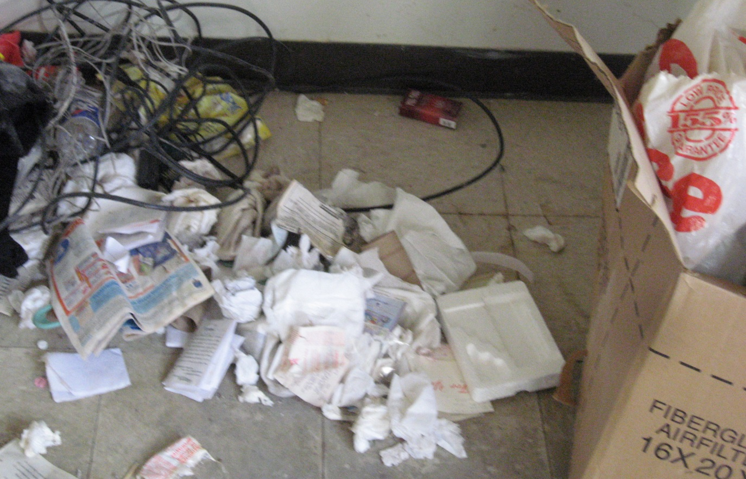
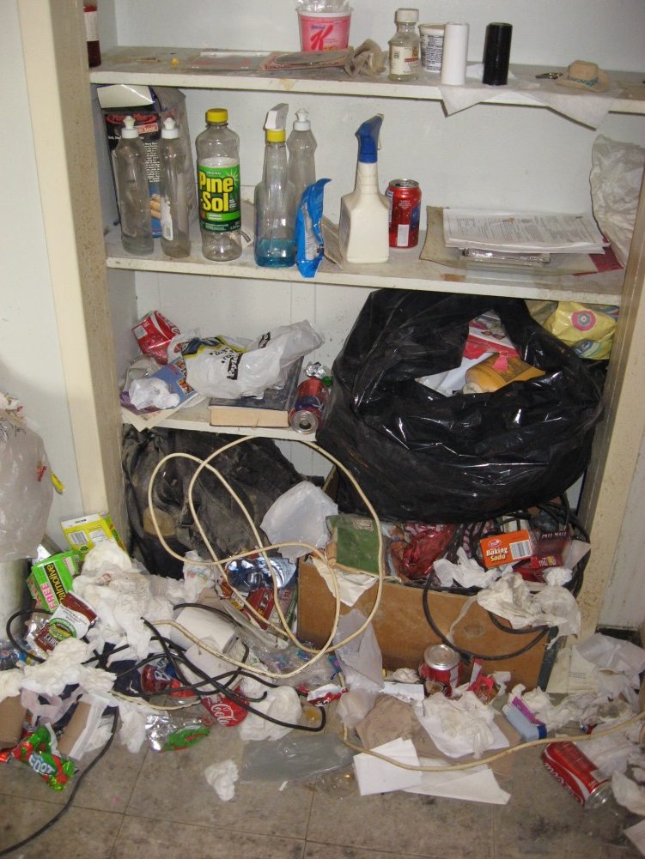
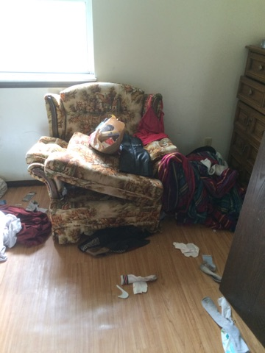
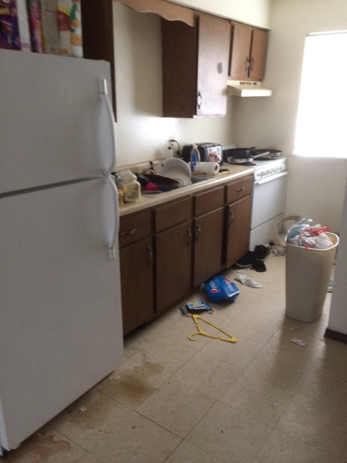
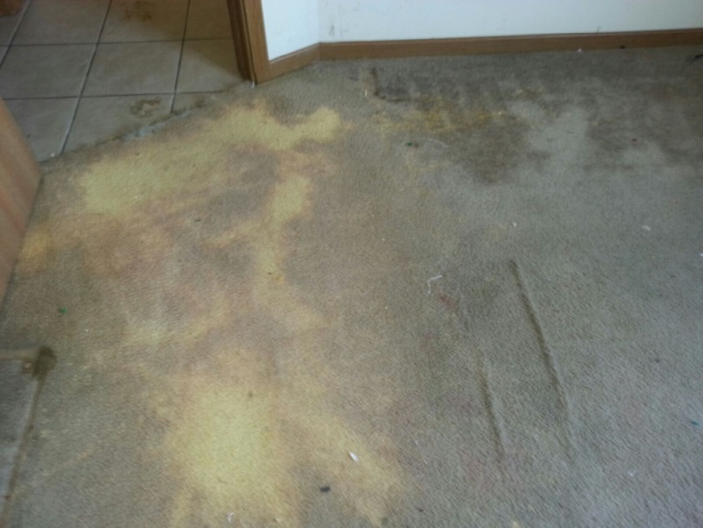
Maintain Your Unit & Appliances
Notes:
EXAMPLE OF NOT MAINTAINING THE UNIT
(actual CHA participant units)

Slide 17

Move-In Inspection Requirements And A Good Place to Live!
How to Spot a Good Place that will Pass Inspection and be Safe and Sanitary for your Family
Notes:
HUD required handbook to assist in finding a passable unit for HQS inspections.

Slide 18

Know Your Rights!
Landlord- Tenant Laws
Court Process
Protecting Victims of Domestic Violence
Crime Victims Rights
Consumer Laws
Sunshine Law
Housing Discrimination (HUD)
VAWA

Slide 19

Lead in your home?
HUD requires Tenants be provided EPA pamphlet
Homes built before 1978 may contain lead based paint, be aware!
Landlords must notify Leasee of lead based paint/ hazards if present before the Lease takes effect.

Slide 20

Where to Look: Housing Search
AffordableHousing.com
Internet
Newspaper
Call
Word of Mouth
Housing Searching Progress Report
(Request for Extension)
Notes:
Briefly go over “progress report,” “request for tenancy approval” (mention it is just a sample & also found in landlord packet)
Explain EIV form was signed during initial appointment which means it is a system that contains household member income & employment information reported to HUD. Basically if you begin working, it will show up. Which is why 10day reporting is important. Specialist will look at annually.

Slide 21
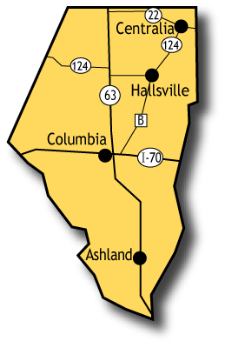
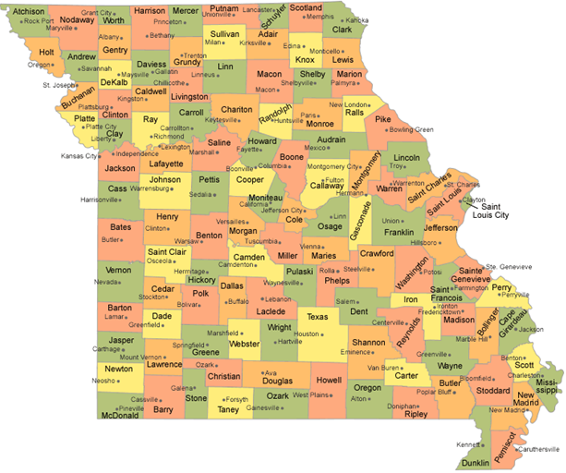
Where you may live
Boone County
Surrounding Counties or States*
Ashland
Centralia
Harrisburg
Hallsville
Hartsburg
Huntsville
Rocheport
Sturgeon
McBaine
Easley
Sapp
Columbia
*Requires Porting
Notes:
Mention that if they do choose to live outside of boone county, they will have to transfer or “port” to another housing agency. Hold up “surrounding areas” info sheet, “where you may live” sheet and name off a few towns, resources page- varies agencies in the area, and “things you should know” sheet (to read over on how not to commit fraud, hud mandated form)

Slide 22
Resources and Referrals
Employment
Education
Basic Needs: Clothes, Food, Household
Utility/Deposit Assistance
Baby/Child Needs
After School
Medical
Elderly Services
Transportation
Legal/Cultural Services
* TerraCom Wireless (Free Smartphone)

Slide 23

Complaint Inspection Procedure
Report to Landlord in Writing (Repair, Date, Time)
Send Copy to CHA
If No Repair, Report to CHA in Writing
CHA 24-Hour Repairs (Emergency Only)
Notes:
Remind them to keep this sheet handy in case the landlord does not fulfill obligations to maintain the unit in a timely fashion. If this does happen they MUST follow procedures. Put everything in writing Go to “payment standard” sheet

Slide 26




Healthy Home Connections
Healthy Home Connections works with participants to connect them to valuable community resources
Healthy Home Connections coordinates with these agencies, and many more;
HHC is located at the JW Blind Boone Community Center at 301 N Providence Rd
Please fill out and return the enclosed brochure to request contact from the Program Coordinator. You must be leased up prior to enrollment.

Slide 27
Family Self Sufficiency
Family Self-Sufficiency Program is a 5-year program designed to assist families in setting and achieving personal goals. With the support of a Program Coordinator, the family sets their own goals. The Coordinator assists the family and, through on-going case management, connects the family with resources based upon their individual needs.
Participating families also may develop an escrow or savings account. The contributions to the account are made with HUD funds and are determined by the earned income and resulting rent portion increases the family experiences during participation in the program.
Please fill out and return the enclosed brochure to request contact from the Program Coordinator. You must be leased up prior to enrollment.

Slide 28



GOOD LUCK &
HAPPY HUNTING!

Slide 29
Questions ?

